Slide 1
IS457 Mobile Applications
Lecture 3
Mobile Programming- Android Studio

Slide 2
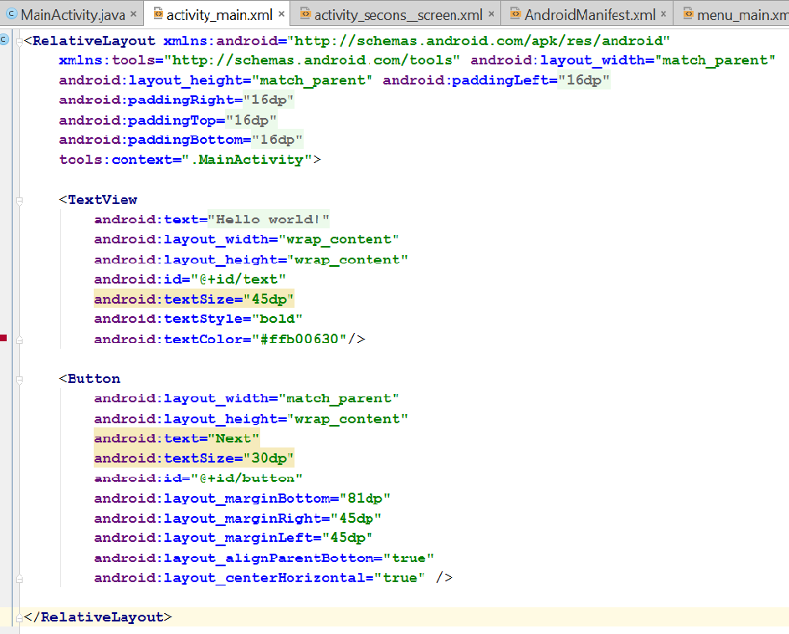
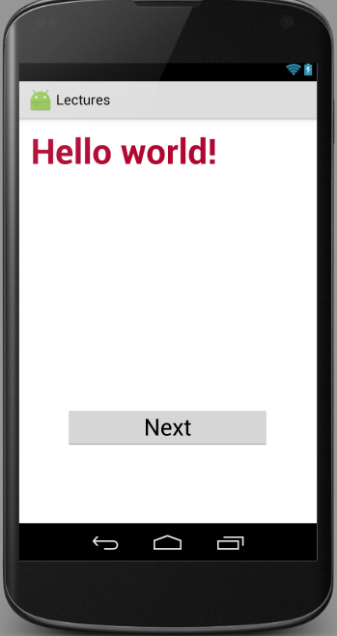
Implementation of Activity UI

Slide 3
Input Events
A way to collect data about a user's interaction with interactive components of Applications such as button presses or screen touch… etc.
Event listeners
is an interface in the View class that contains a single callback method.

Slide 4
Input Events
Interface | Method | Description
View.OnClickListener | onClick() | when the user either clicks or touches or focuses upon any widget like button, text, image etc
OnLongClickListener() | onLongClick() | when the user either clicks or touches or focuses upon any widget like button, text, image etc. for one or more seconds
OnTouchListener() | onTouch() | when the user performs an action qualified as a touch event, including a press, a release, or any movement gesture on the screen.

Slide 5
Example
public class MainActivity extends Activity { TextView txt; Button btn; @Override protected void onCreate(Bundle savedInstanceState) { super.onCreate(savedInstanceState); setContentView(R.layout.activity_main); txt= (TextView) findViewById(R.id.text); btn=(Button) findViewById(R.id.button); btn.setOnClickListener(new View.OnClickListener() { @Override public void onClick(View v) { txt.setTextColor(Color.BLUE); btn.setBackgroundColor(Color.parseColor("#ff3398")); Toast.makeText(getBaseContext(),"Color Changed", Toast.LENGTH_SHORT).show(); } }); }

Slide 6
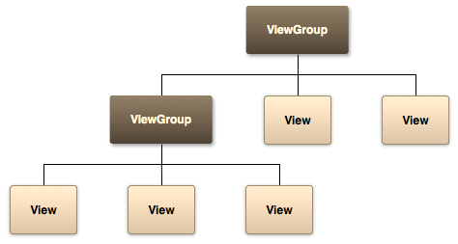
Lab Work
Create an Android Studio activity that simulates the diagram below. include as many view attributes as you could.
change the text size programmatically

